Slide 1
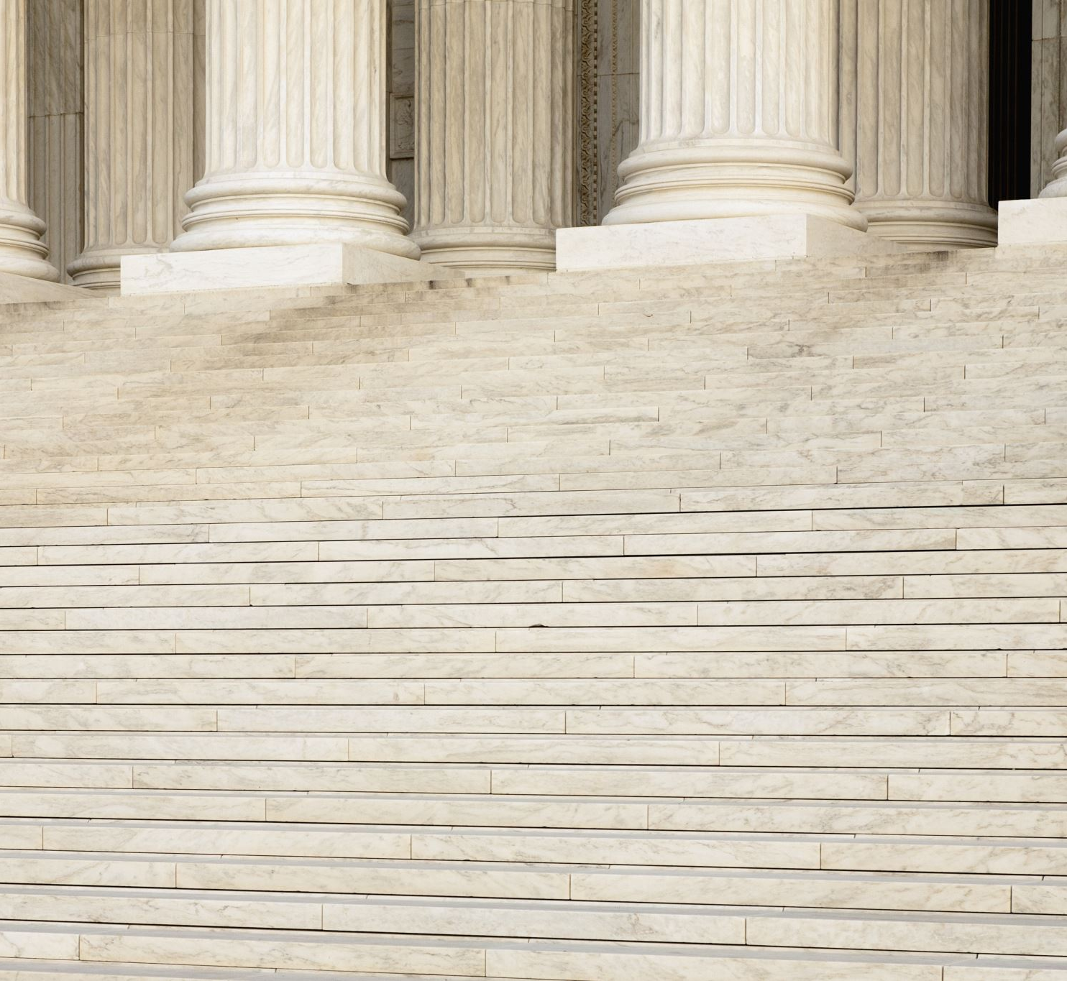
Doctrine of Precedent

Slide 2
Learning Intentions
Success Criteria
Define the terms "precedent"
Explain why precedent are important
I can….
Define the term precedent.
Explain why precedents are important
Explain the advantages and disadvantages of precedents

Slide 3
Think quietly to yourself, of a time when a parent, guardian, or teacher made a decision about something they did, based on a similar situation in the past.
Now, thinking quietly about the answer to these questions: Was his or her decision fair? Why or why not?

Slide 4
Hmm… how about these examples
"You need to be home at 10:30 p.m. because your older sister needed to be home at 10:30 p.m. when she was your age."
“This assignment was due yesterday. You've known for months that my policy is to take off 10 percent of the possible points every day it is late. I'm sticking to that."

Slide 5
Now, give an example of a time when you thought your parent, guardian, or teacher should not have applied the same old rules or reasons to a new situation.

Slide 6
So….
"But my sister was my age more than 15 years ago. Times have changed and nobody comes home at 10:30 anymore."
"But my grandmother was rushed to the hospital the night before last and I had to stay with her because my parents could not leave work. I did finish the project last night as soon as I could."

Slide 7
Now, think about a time when your parent, guardian, or teacher seemed to ignore their own previous decision.
Did that seem fair? Why or why not?
What are the benefits and risks of sticking by the known rules?
What are the benefits and risks of changing the rules for new situations?

Slide 8
you have just been talking about something very similar to the term "precedent.“
So, write in your own words, what do you understand by this new term ‘precedent’?

Slide 9

A precedent is a decision that is the basis or reason for future decisions.
An example of precedent is the legal decision in Brown v. Board of Education guiding future laws about desegregation.

Slide 10

The Supreme Court justices wrestle with the issue of precedent on a daily basis, knowing that their decisions will affect not just the people in a particular case, but potentially millions of other Australians who could be in similar situations in the future.
Their questions, like those mentioned in our previous slides, are typically about when precedents should be honored and when they should be reversed.
Different justices often have different views on this -- some even change their views over time.

Slide 11


The Role of the Judge
New and unusual cases come up in Australian courts every day and sometimes the parliament made, statutory law is not clear about how a particular case should be dealt with.
So a judge from a superior court must make a decision on how to resolve the issue in a fair and just way.
This decision sets a precedent.
Now, watch this video to understand what the doctrine of precedent is all about.

Slide 12

Importance of precedents
Each court decision is supposed to be based on an earlier decision, which is called “precedent.” To show that your constitutional rights have been violated, you point to good court decisions in earlier cases and describe how the facts in those cases are similar to the facts in your case.

Slide 13
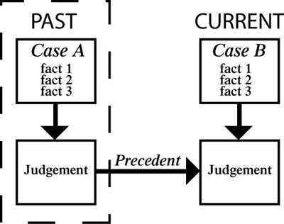
What is a Precedent?
A precedent means that any similar cases in the future should be dealt with in the same way.
Notes:
Image sourced from Lawgovpol.com

Slide 14

Understanding Precedent
To understand the system of precent, think about these school incidents.
Case 1: You arrive late to school because you slept in. Your teacher gives you detention.
Case 2: Your friend arrives late to school because she slept in. The teacher uses case 1 as a precedent.

Slide 15
Question 1.
Should the teacher give your friend a detention?
Why?

Slide 16
Answer
These are the same circumstances, so the decision should be consistent.
GIVE A DETENTION.

Slide 17
Case 3:
Your friend arrives late the next day because the school bus broke down.

Slide 18
Question 2:
Should the teacher use Case 1 and Case 2 as precedents and give a detention? Why?

Slide 19
Answer:
This is different because it was not the student’s fault.
Cases 1 and 2 are not precedents for Case 3.
NO DETENTION.

Slide 20
Case 4:
You are your friend arrive late because you thought the bus was still broken down (but it had been fixed), so you just took your time to get there.

Slide 21
Question 3:
Are Cases 1, 2 or 3 precedents for this situation?
Should the teacher give you a detention?
Why?

Slide 22
Answer
Cases 1 and 2 are precedents because being late was your fault.
DETENTION

Slide 23
Case 5:
You leave school early because you are bored with school.

Slide 24
Question 4:
Can Case 1 be used as a precedent for deciding whether or not to give you a detention?
Why?

Slide 25
Answer
Case 1 is a precedent, because it and this case are both about you not being at school through your own fault. It does not matter that Case 1 is about arriving late and Case 5 is about leaving early as the principles is the same.
DETENTION

Slide 26
How does this relate to Common Law?
Among other things, judges look at cases from the past that are similar in facts or principle to make decisions about penalty. A judge in a theft case might make a decision based on a case that happened hundreds of years ago.
Alternatively, although the facts are similar – for example, both cases might involve stealing a loaf of bread – the judge may decide that different conditions in society then and now mean that today’s case should not be decided in the same way.

Slide 27
Common law is the law developed by judges over time, based on decisions in previous cases.
These decisions are recorded in special law report books to which lawyers can refer to argue their cases and judges can refer to make their decisions.
It is only the decisions of the highest and most important courts that are recorded and referred to in this way.

Slide 28
Statute and Common Law
Statute law is made in parliament.
Common law is made in the courts.
Common law is generally made by setting a ‘precedent’, which means no other law applies to the case that is being presided over.

Slide 29
Civil and Criminal Law
Civil law impacts on just a few people.
Criminal law impacts on the whole society.
Criminal laws are made about crimes that are generally more serious than common law-based crimes.

Slide 30
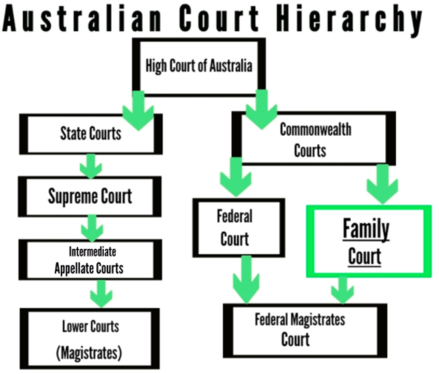
The court’s version or interpretation of the law is the ratio decidendi (the reason behind the decision) and binding direction for future judges; the expectation means that lower courts follow the binding precedent based on the reasoning of higher court decisions.
Notes:
Image and text sourced from https://unistuff977075235.wordpress.com/

Slide 31
Which of the following best describes the legal system of Australia?
Appeals flow down and precedents flow up.
Precedents are initiated by parliament.
Precedents flow down and appeals flow up.
Appeals are only heard by the Federal Court.

Slide 32
Which of the following best describes the legal system of Australia?
Appeals flow down and precedents flow up.
Precedents are initiated by parliament.
Precedents flow down and appeals flow up.
Appeals are only heard by the Federal Court.

Slide 33
What is the meaning of ‘on the balance of probabilities’?
The judge believes that there is sufficient evidence to show that it is likely the defendant harmed the plaintiff in some way.
It is believed that the plaintiff is guilty beyond reasonable doubt of the accusations against them.
The jury has convicted the accused based on the evidence presented to them by the prosecution.
The offender is more than likely to re-offend and imprisonment is the best option for sentencing and providing compensation.

Slide 34
What is the meaning of ‘on the balance of probabilities’?
The judge believes that there is sufficient evidence to show that it is likely the defendant harmed the plaintiff in some way.
It is believed that the plaintiff is guilty beyond reasonable doubt of the accusations against them.
The jury has convicted the accused based on the evidence presented to them by the prosecution.
The offender is more than likely to re-offend and imprisonment is the best option for sentencing and providing compensation.

Slide 35
What is meant by the phrase ‘the punishment must fit the crime’?
The plaintiff must pay just compensation for their actions.
Offenders have to go to jail for justice to be done.
The sentence of the court should not be too harsh nor too lenient.
The defendant must attend mediation before going to court.

Slide 36
What is meant by the phrase ‘the punishment must fit the crime’?
The plaintiff must pay just compensation for their actions.
Offenders have to go to jail for justice to be done.
The sentence of the court should not be too harsh nor too lenient.
The defendant must attend mediation before going to court.

Slide 37
Which of the following is not an example of a civil dispute?
throwing a brick through a shop window
not following through on an agreement to buy a car
writing a blog which includes falsehoods about a person or their character
leaving electrical wiring exposed without leaving appropriate warning signs

Slide 38
Which of the following is not an example of a civil dispute?
throwing a brick through a shop window
not following through on an agreement to buy a car
writing a blog which includes falsehoods about a person or their character
leaving electrical wiring exposed without leaving appropriate warning signs

Slide 39
Which is the most correct reason for the hierarchy of courts in Australia?
It follows the principles of the separation of powers by providing separation of church and state.
There is a need to separate cases, so they are dealt with before precedent expires.
When Australia became a country, the Westminster system was adopted and never changed.
It allows for specialist knowledge and efficiency in dealing with legal matters.

Slide 40
Which is the most correct reason for the hierarchy of courts in Australia?
It follows the principles of the separation of powers by providing separation of church and state.
There is a need to separate cases, so they are dealt with before precedent expires.
When Australia became a country, the Westminster system was adopted and never changed.
It allows for specialist knowledge and efficiency in dealing with legal matters.

Slide 41
Which is the most correct reason for the hierarchy of courts in Australia?
It follows the principles of the separation of powers by providing separation of church and state.
There is a need to separate cases, so they are dealt with before precedent expires.
When Australia became a country, the Westminster system was adopted and never changed.
It allows for specialist knowledge and efficiency in dealing with legal matters.

Slide 42
Advantages and disadvantages of precedents
Watch this video and make a table like below to take notes from the video
Advantages of precedents | Disadvantages of precedents

Slide 43
Although many court cases follow existing laws, some cases set new precedents or interpret the law in different ways. As a result, these cases become historic and controversial, influencing how we view future cases for years to come.
Now, Let’s take a look at some of the most famous cases in the history of Australian law.

Slide 44
Mabo vs Queensland (No 2) – 1992
Mabo vs Queensland (No 2) is arguably the most famous court case in Australian history. The case rewrote national land law, recognising indigenous Australians as the original inhabitants of Australia. It also ultimately led to indigenous Australians securing an apology from Prime Minister Kevin Rudd.
Overall, the case took over a decade to reach the final conclusion, allowing indigenous people across Australia to claim traditional rights to unalienated land.

Slide 45
Chamberlain vs the Queen – 1984
A murder trial that proved that the truth can be stranger than fiction, this case was one of the most widely broadcasted murder trials in history.
The case centred around the death of an infant on a camping holiday. The prosecution claimed that she had been murdered by her mother, while the mother claimed she had been taken by a dingo.
In spite of questionable blood testing, poor eye-witness testimony that often backed the defendant and a forensic scientist who had their evidence overturned in previous trials, Chamberlain was found guilty.
New evidence emerged in 1986 that the child may have in fact been killed by a dingo (this was corroborated in 2012), meaning that Chamberlain was released and eventually acquitted.

Slide 46
Al-Kateb vs Godwin – 2004
The case of Ahmed Al-Kateb is arguably Australia’s most famous and controversial immigration case. Born in Palestine to Kuwaiti parents, Al-Kateb was stateless. When he was refused a temporary protection visa in Australia, he could not be returned to his country of origin.
In its ruling, the High Court decided that he could be detained indefinitely and that it was lawful to indefinitely detain any stateless person. Huge controversy surrounded the decision, which led to Immigration Minister Amanda Vanstone reviewing the cases of 24 stateless people in immigration detention.
In addition, other countries found this indefinite detention unlawful due to the European Convention on Human Rights. Al-Kateb was eventually released (alongside others) and was awarded a permanent visa in 2007.

Slide 47
Commonwealth vs Tasmania – 1983
Our final court case is a constitutional landmark and an environmental victory. The case saw the Federal and Tasmanian governments clash in the High Court over the construction of a hydroelectric dam. While the Tasmanian Government believed that they had a legal right to build the dam, the Federal Government opposed it under the World Heritage Convention.
The Federal Government won a 4:3 majority in the High Court, setting not only a new legal precedent, but also preserving a key piece of Australian wilderness.

Slide 48
These are just a few examples of hugely influential and controversial cases in Australian law.
Although the vast majority of cases follow precedents, it’s always interesting to see how the law evolves and is applied.

Slide 49

